Slide 1

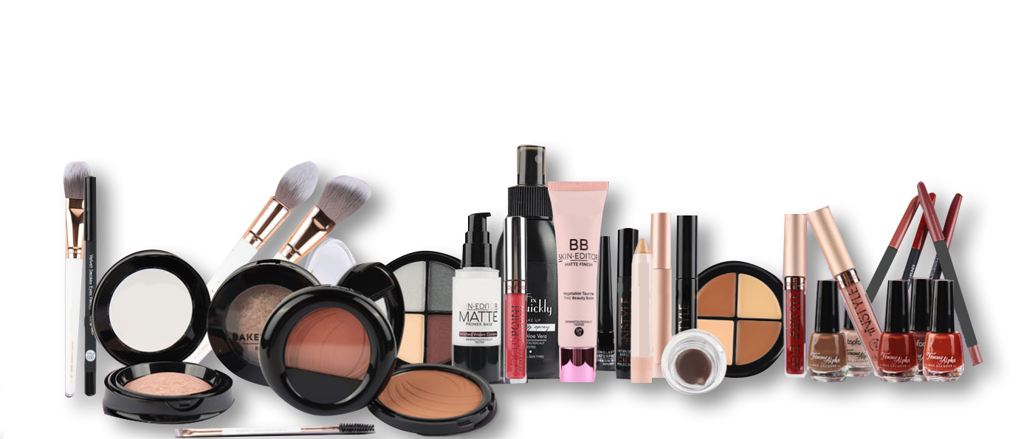

5 minute infro of China Guangzhou Vast cosmetic
Our company Guangzhou Vast Cosmetic Co.,Ltd was established in 2018, a high-tech enterprise focusing on customizing make-up for customers, integrating scientific research, production, sales and service 。
We focus on making middle and high-end quality products.We help many foreign brands build from scratch and create high-quality and competitive brands for customers.
Welcome to contact us, we can make samples for you free, and look forward to developing together with your brand.
AND MORE

Slide 2
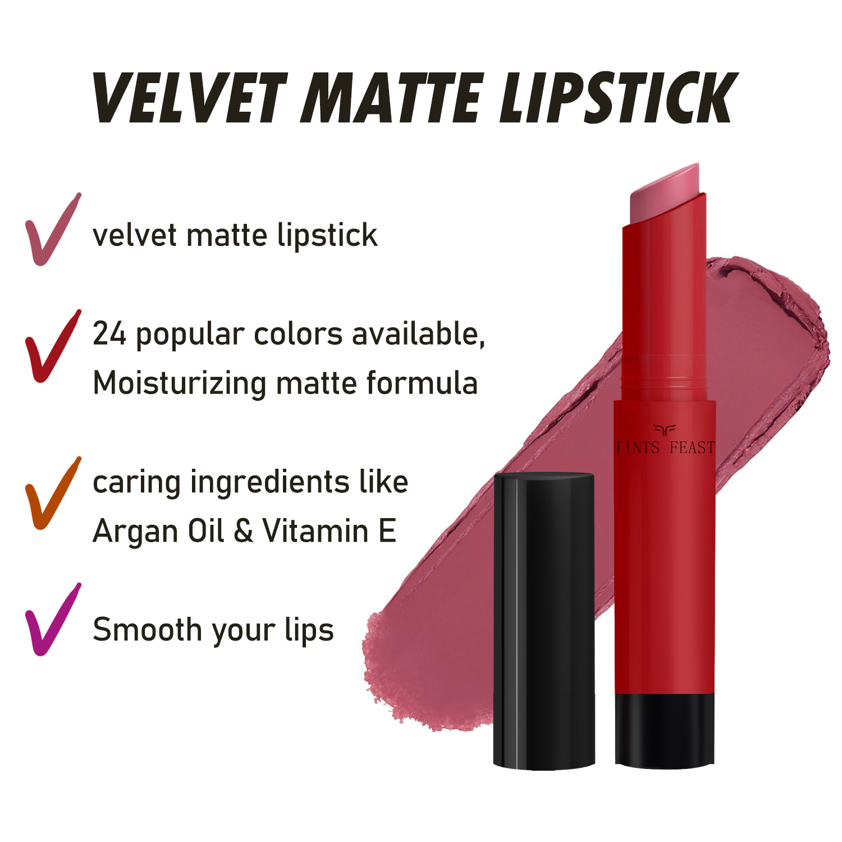
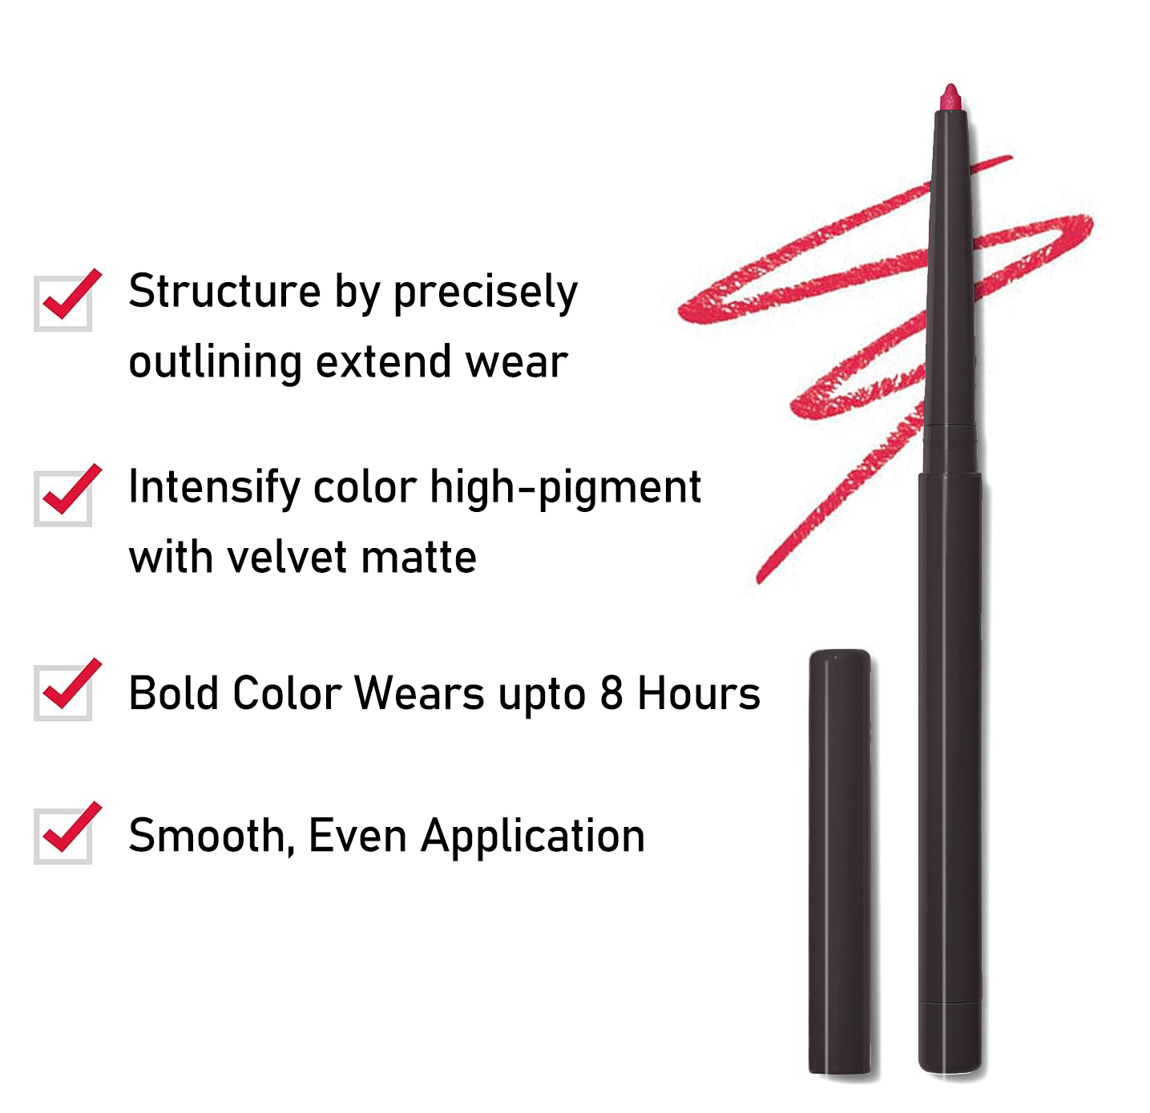
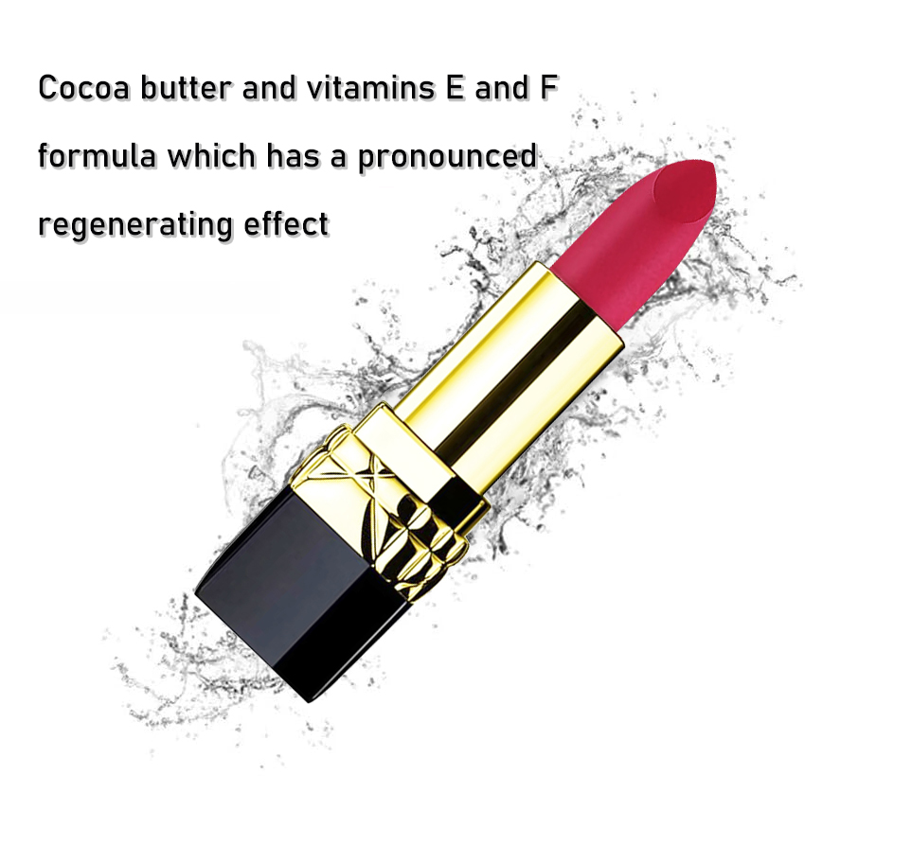
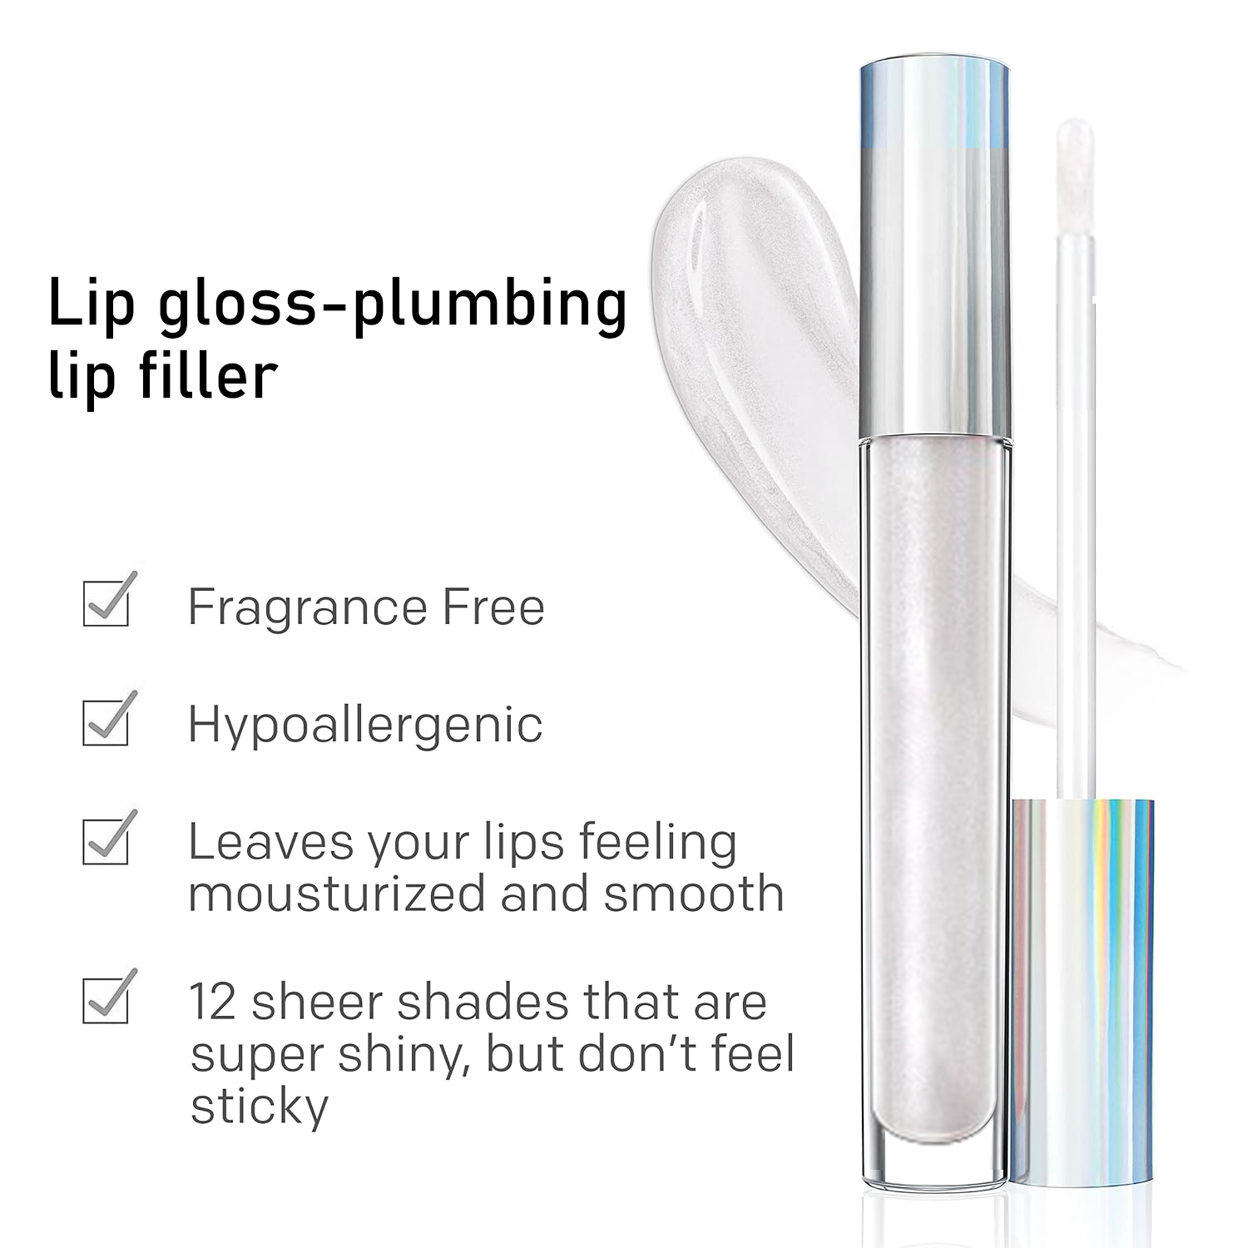
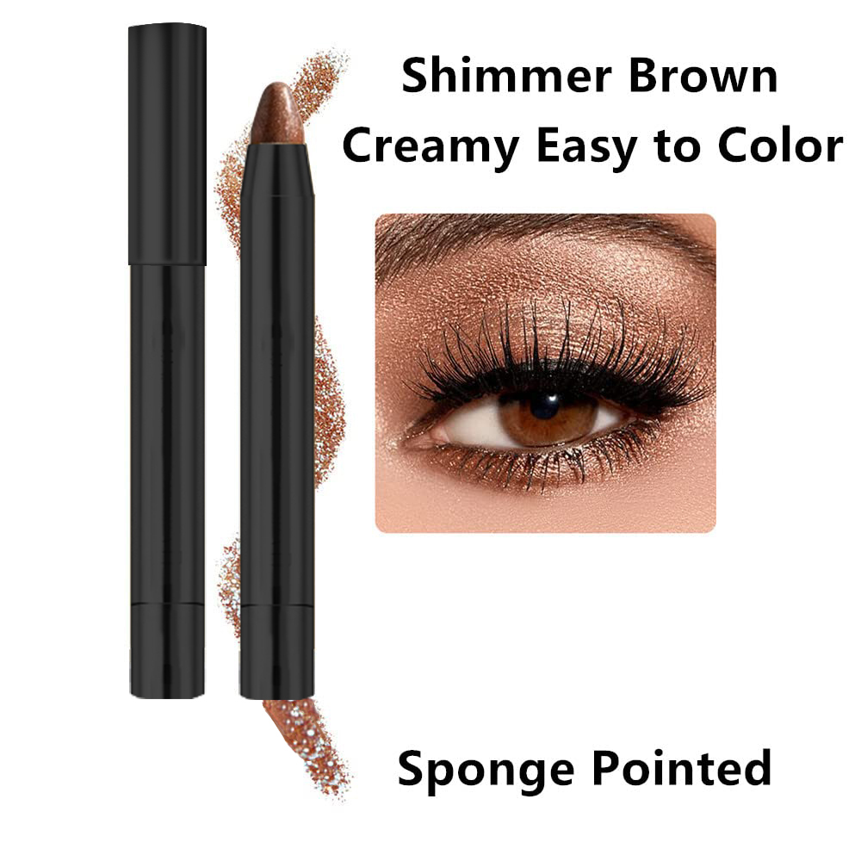
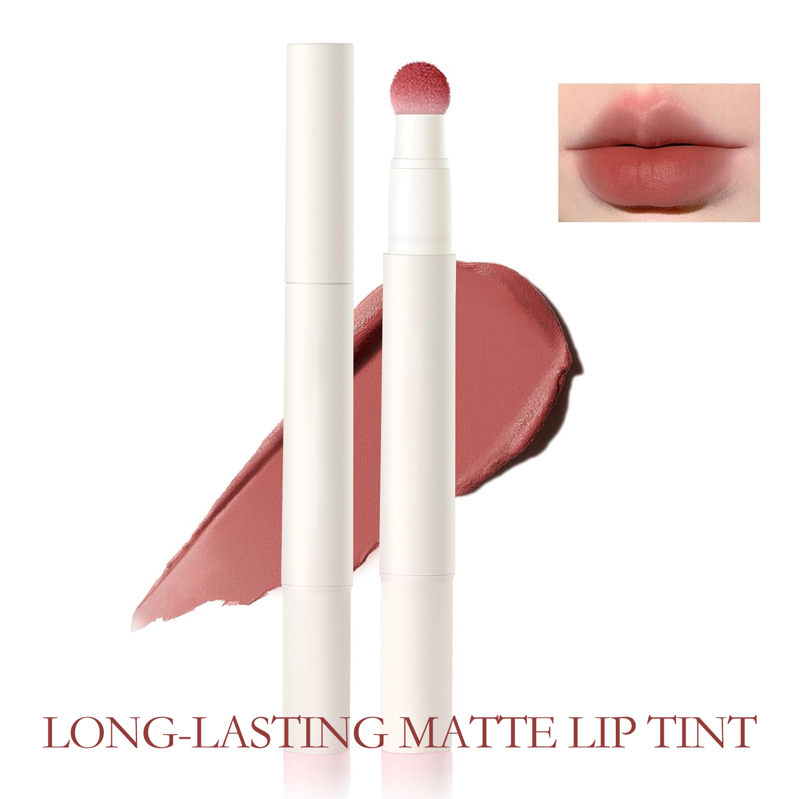
Our Development

Slide 3

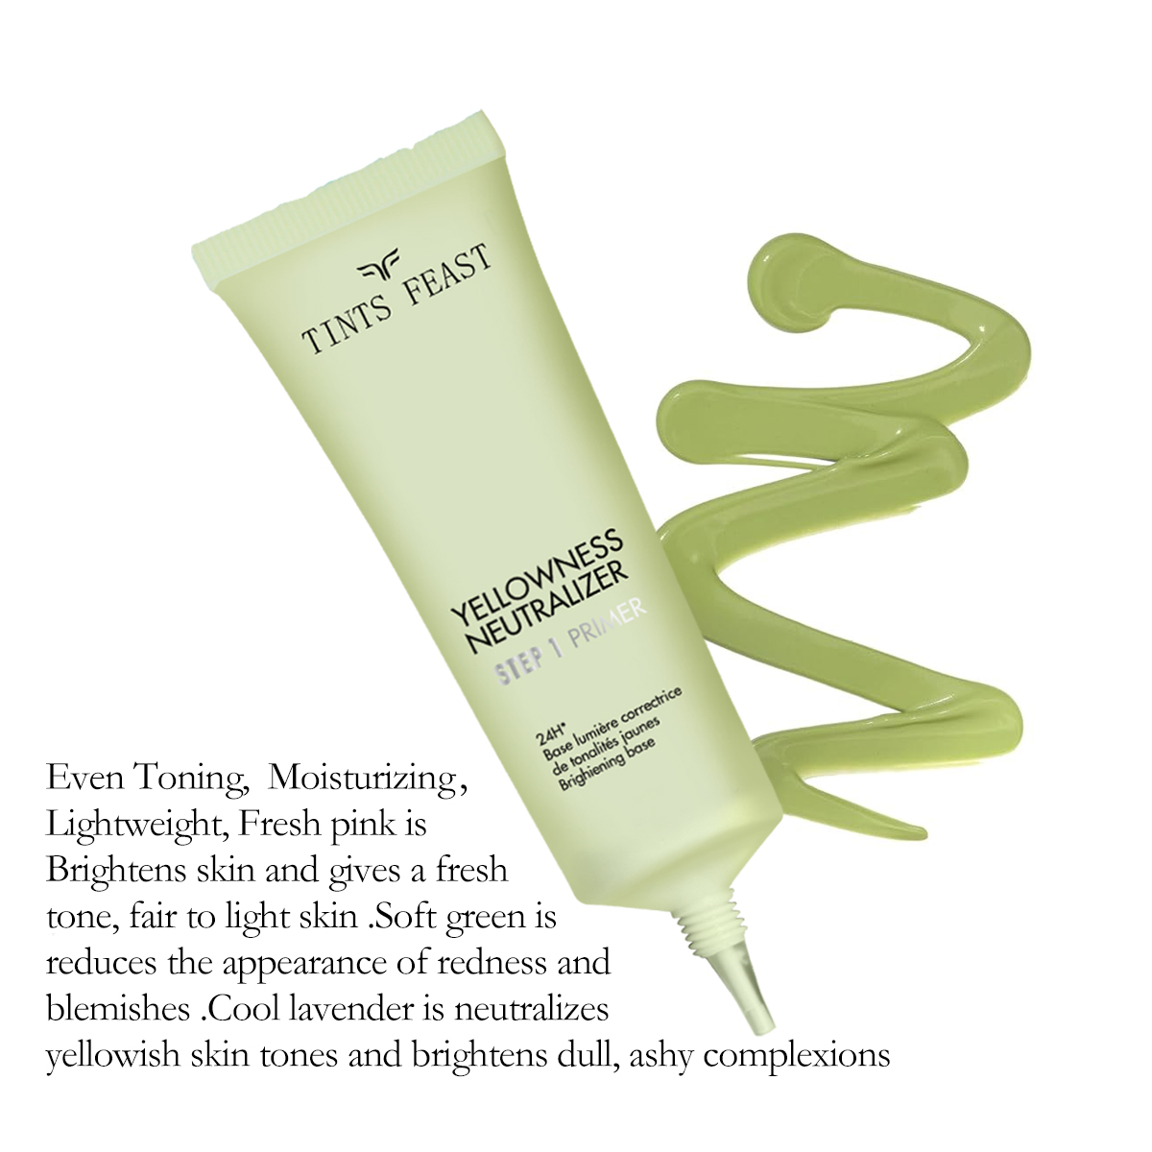
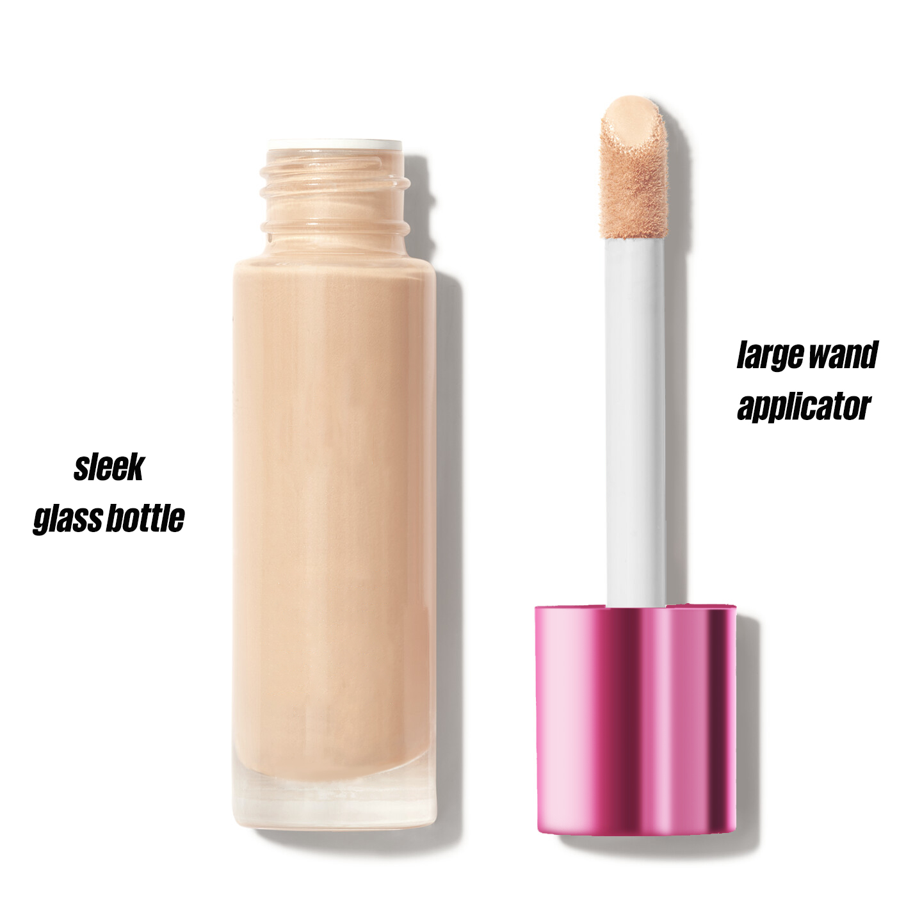
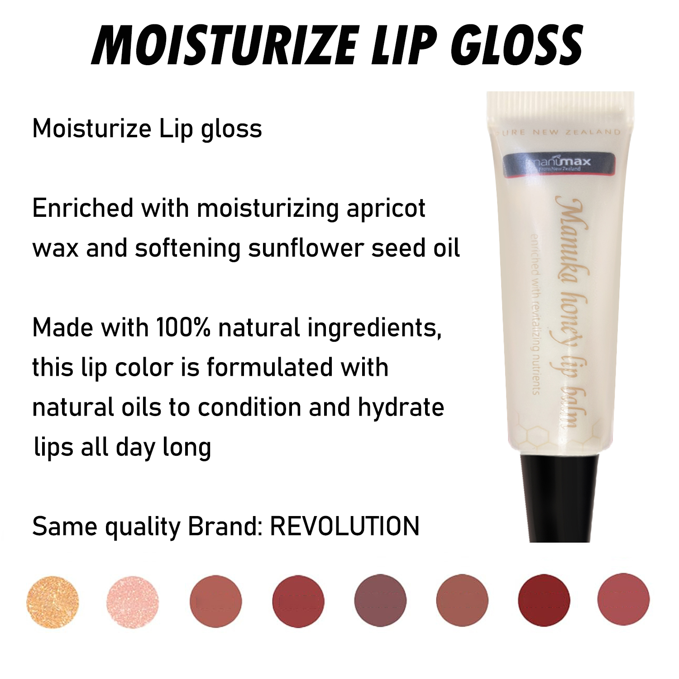
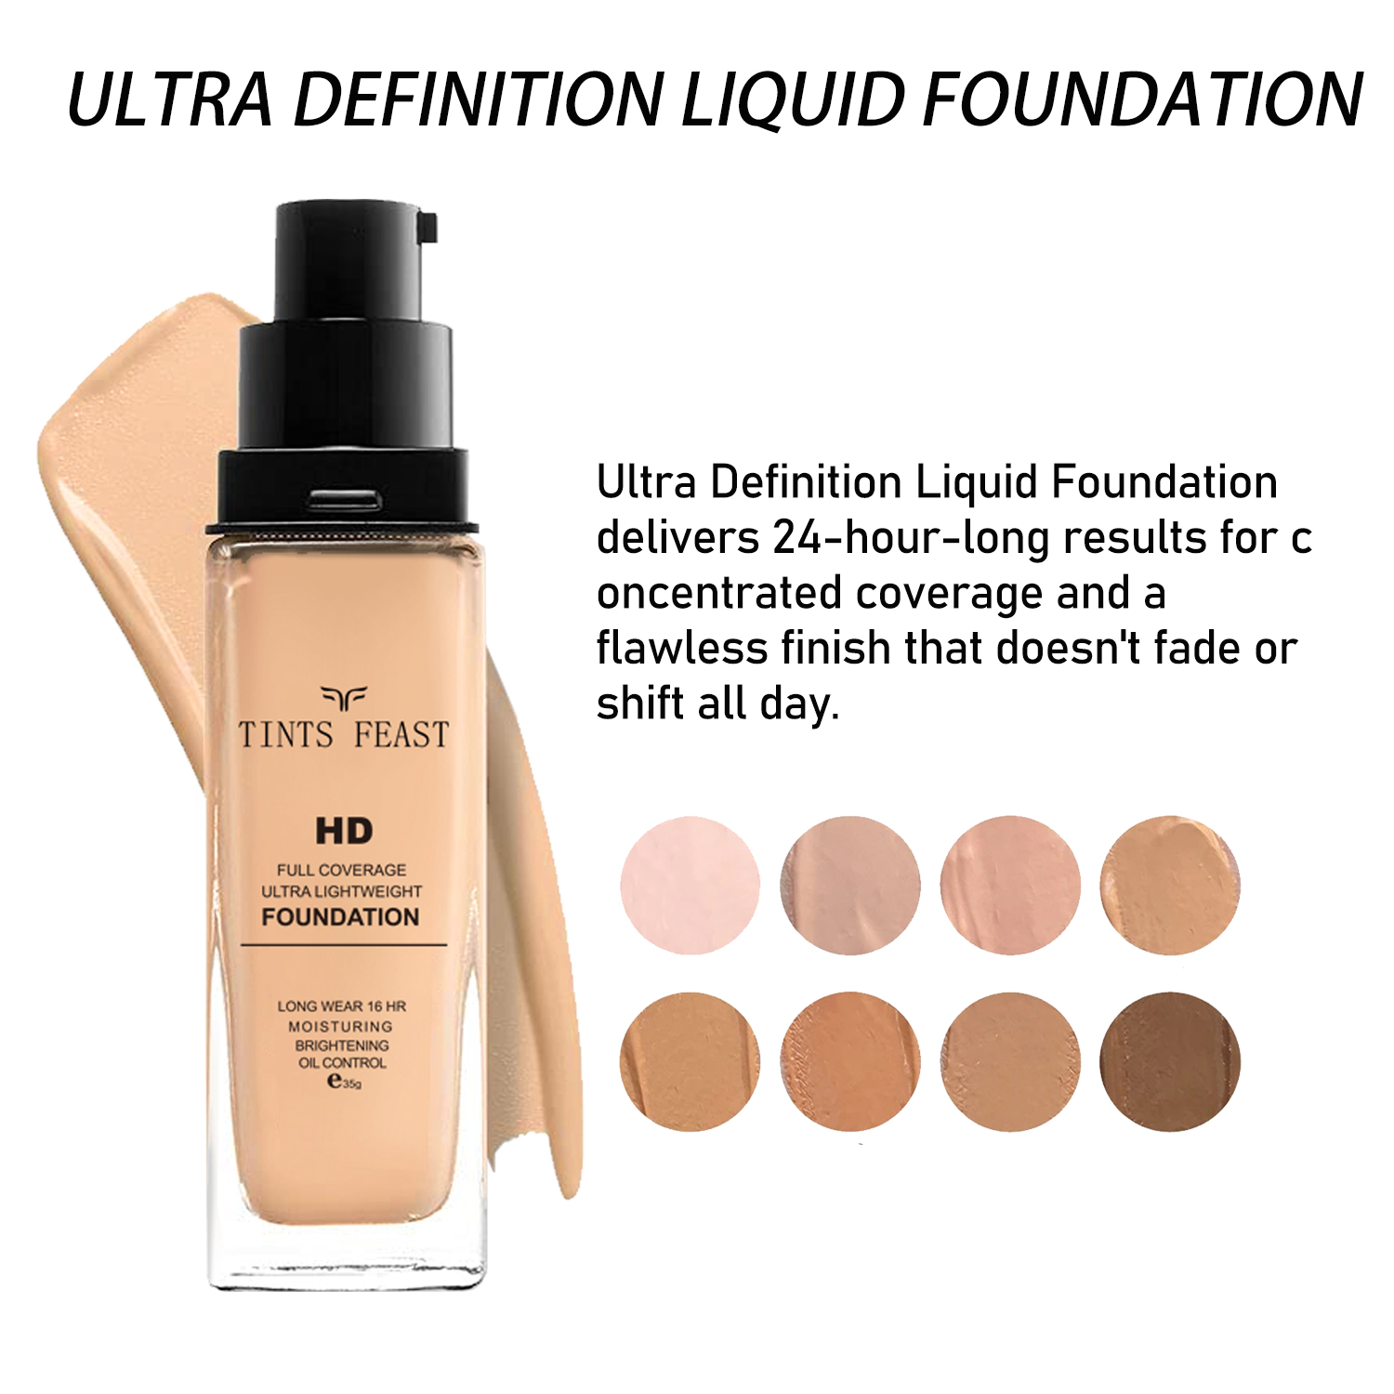
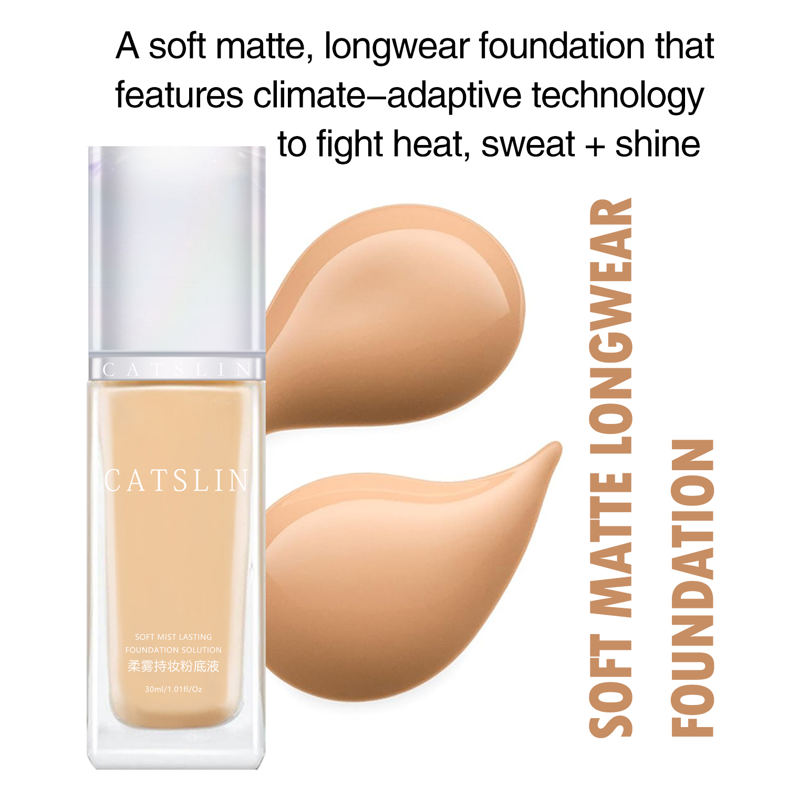
Our Development

Slide 4
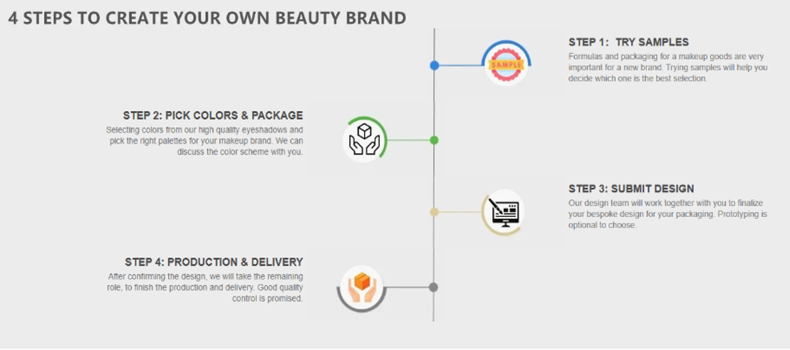
How do we make your product?

Slide 5
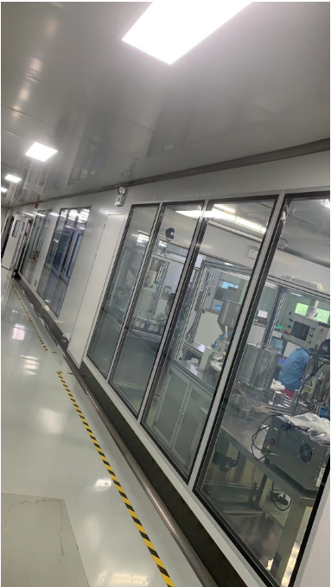
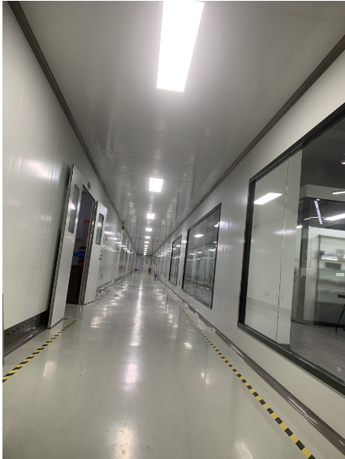
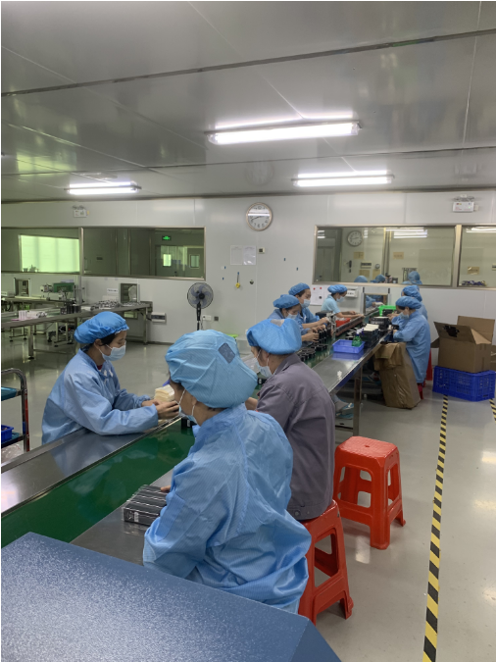



You can trusted
Guangzhou Vast Cosmetic Co.,Ltd , a manufacturer who specialized in color cosmetics for 10 years continuing creating ,growing and innovating.
We’re one of the leading firms in the Cosmetic industry, located in Guangzhou City.
Achieved international certificates such as ISO9001, ISO22716, TUV/SASO, GMP, MSDS, FSC, etc.
We do strict quality control and all product produce in Dust-free line.

Slide 6
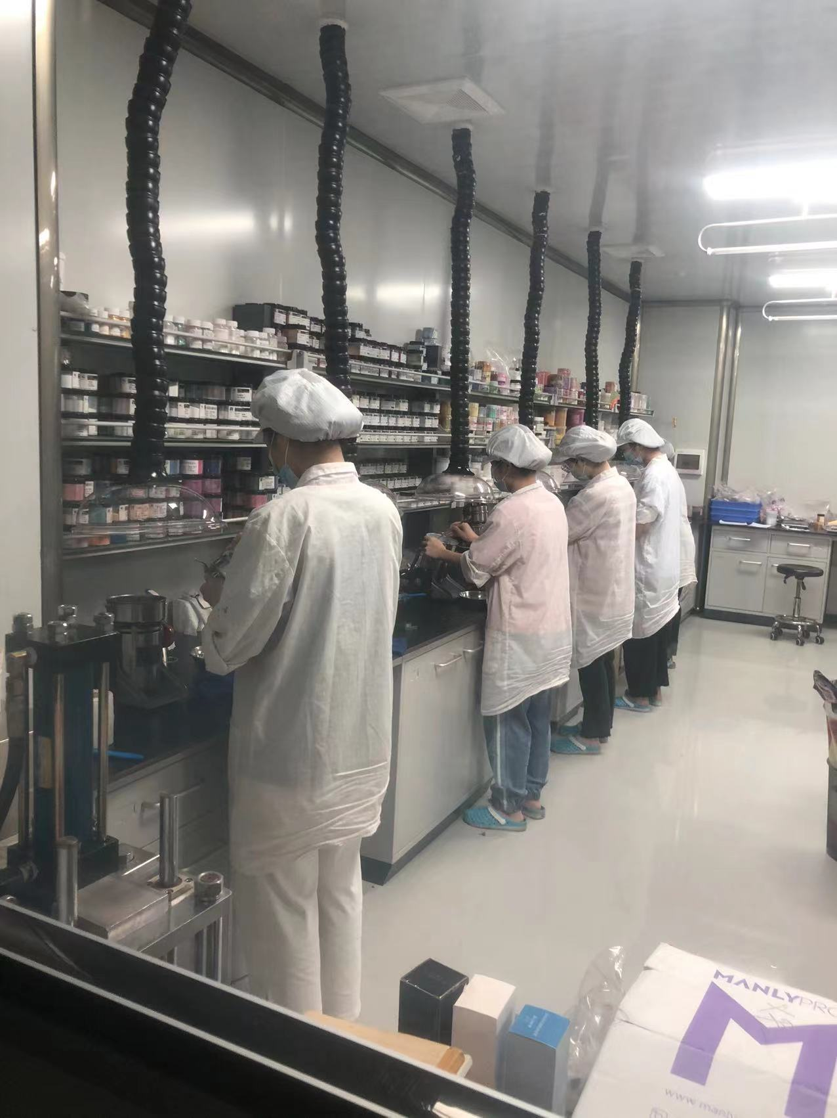
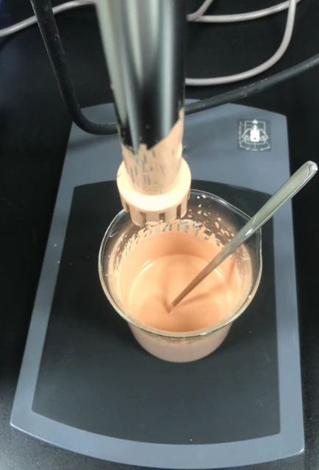
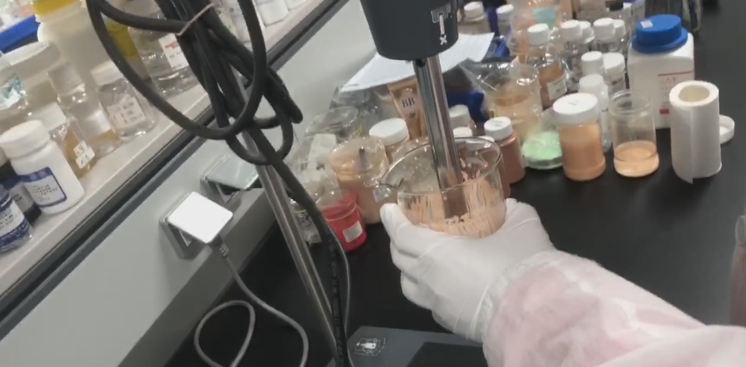
We have our own lab and RD team to help client develop formula and do the color-matching.

Slide 7
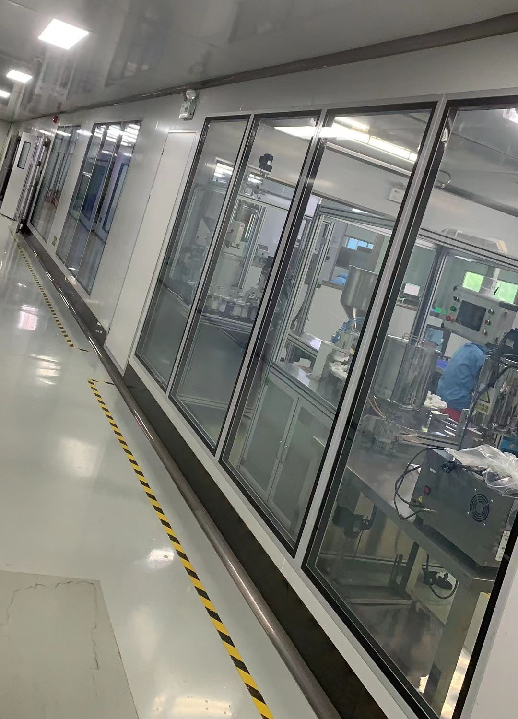
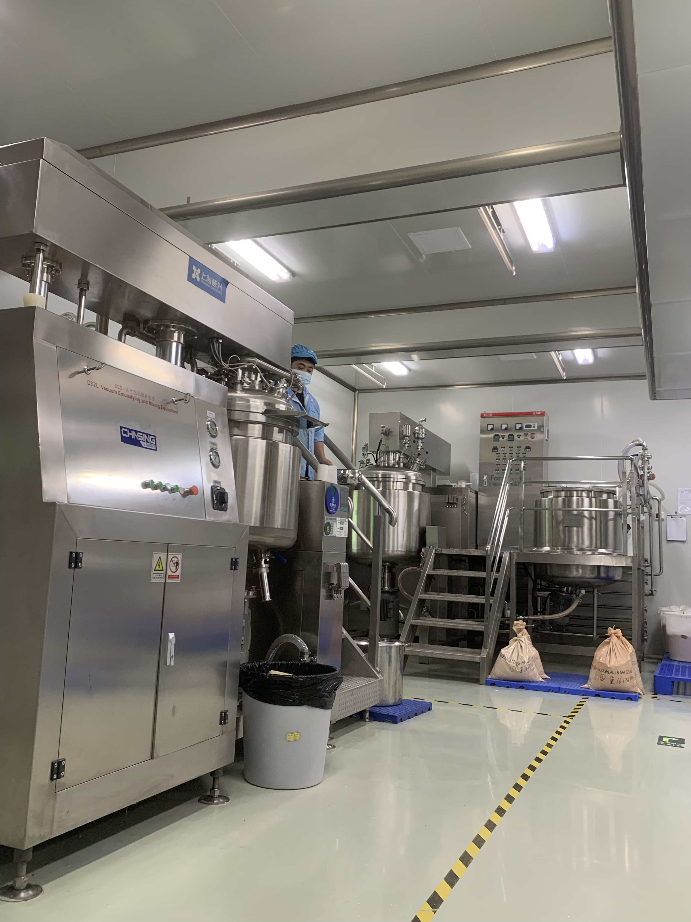
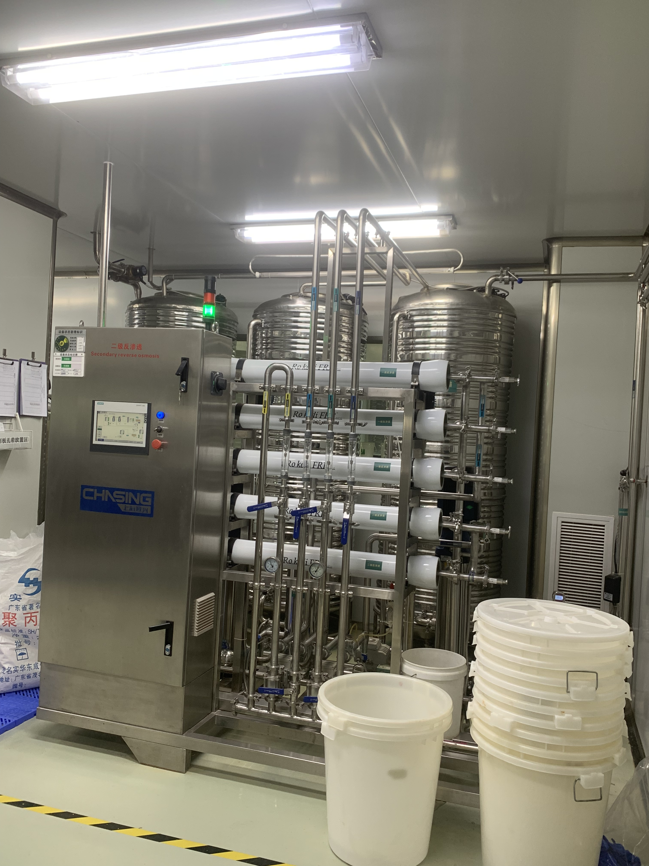
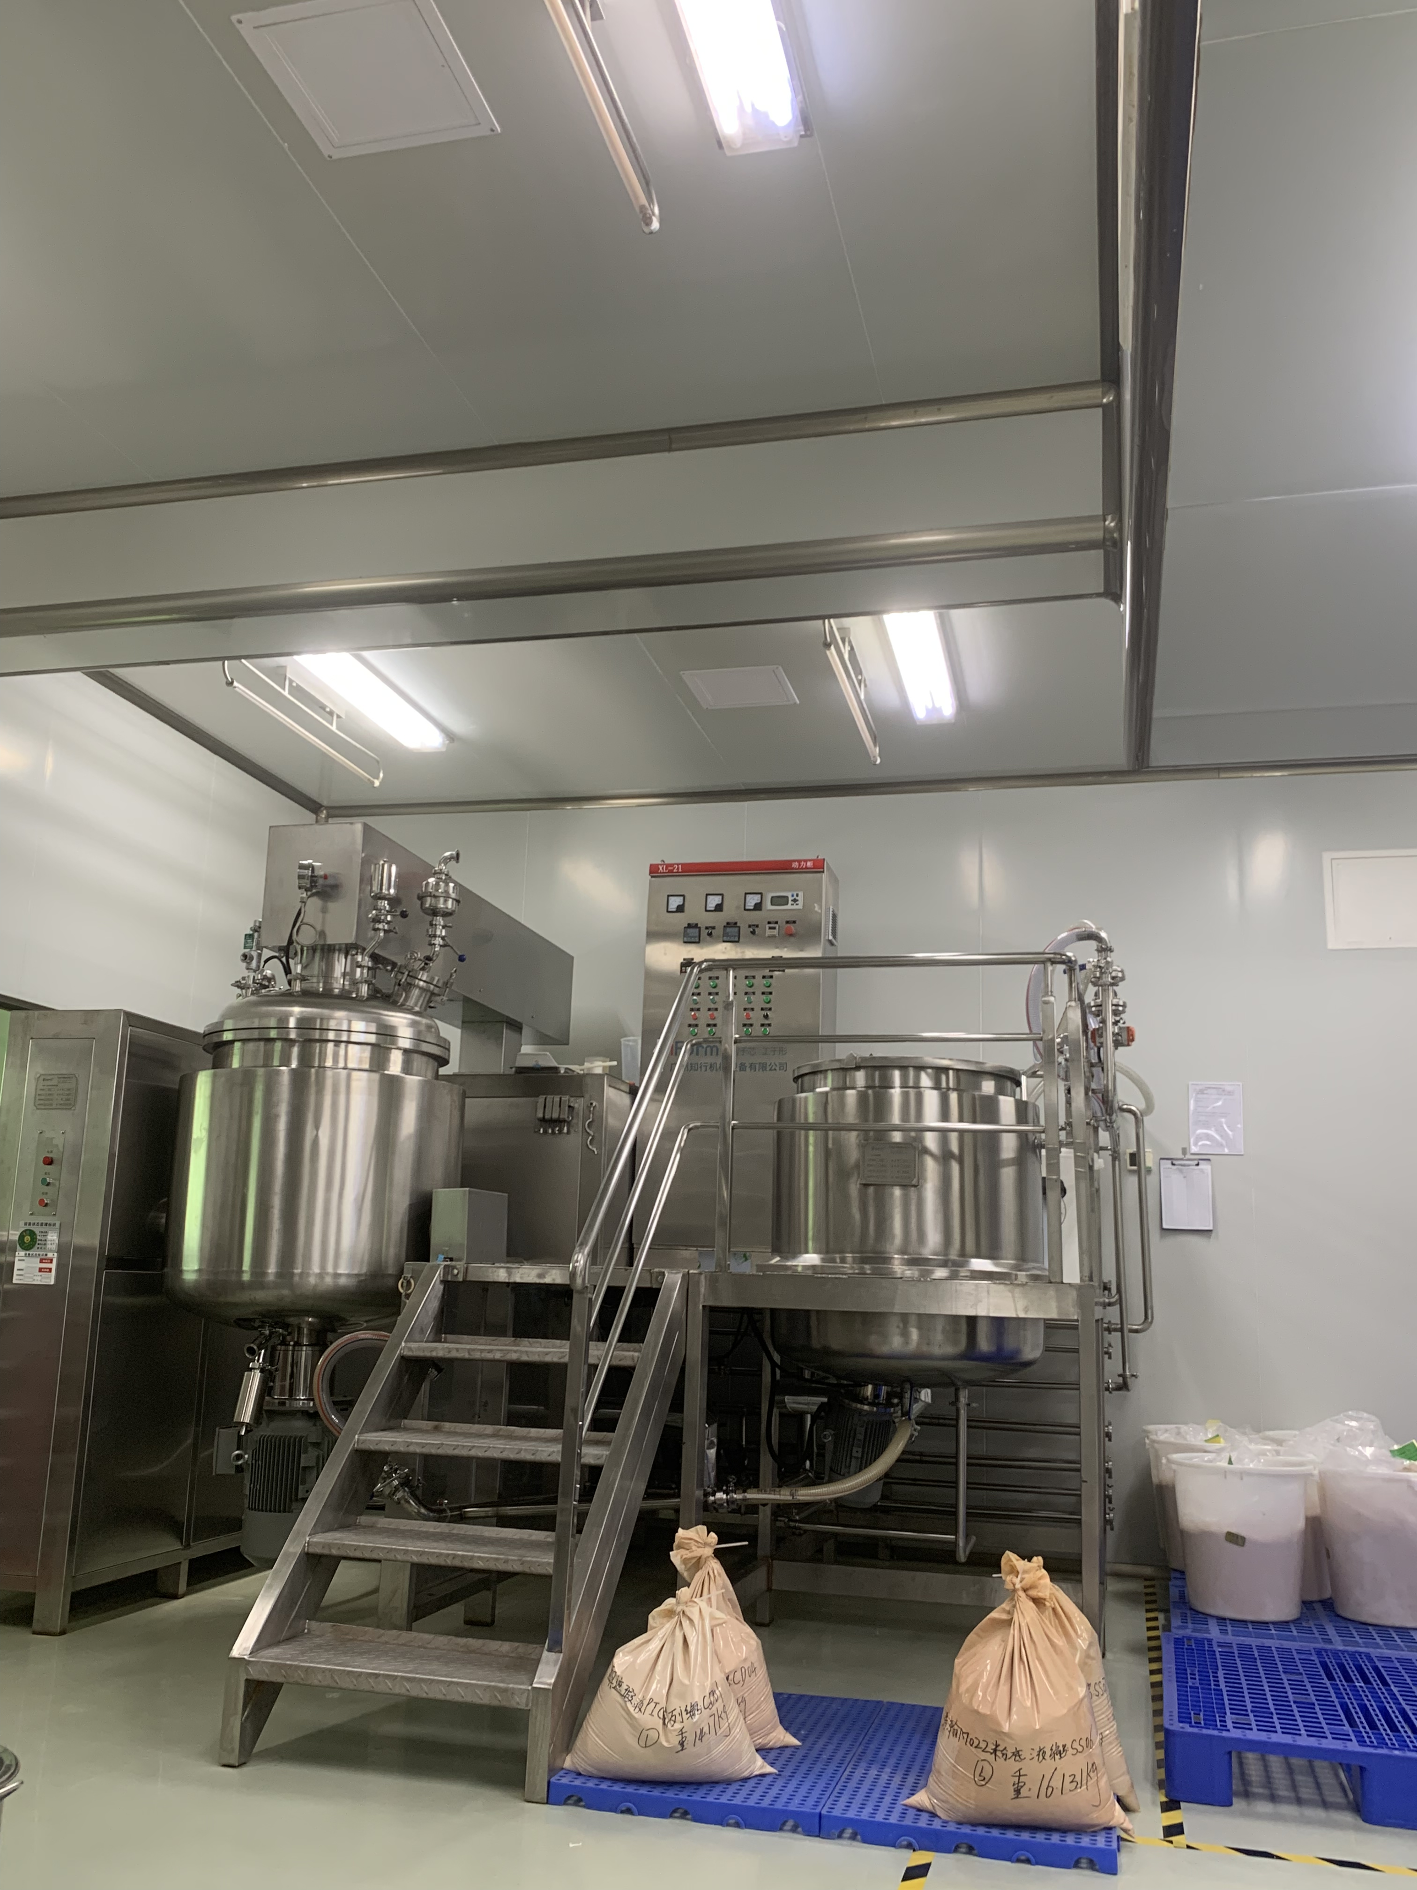
0 2
Equipment
production
Vast cosmetic With professional precision technology and automation equipment, we continue to develop in professional and innovative fields to provide customers with high-quality technical support for their projects and achieve a one-stop service experience from scratch to better.

Slide 8
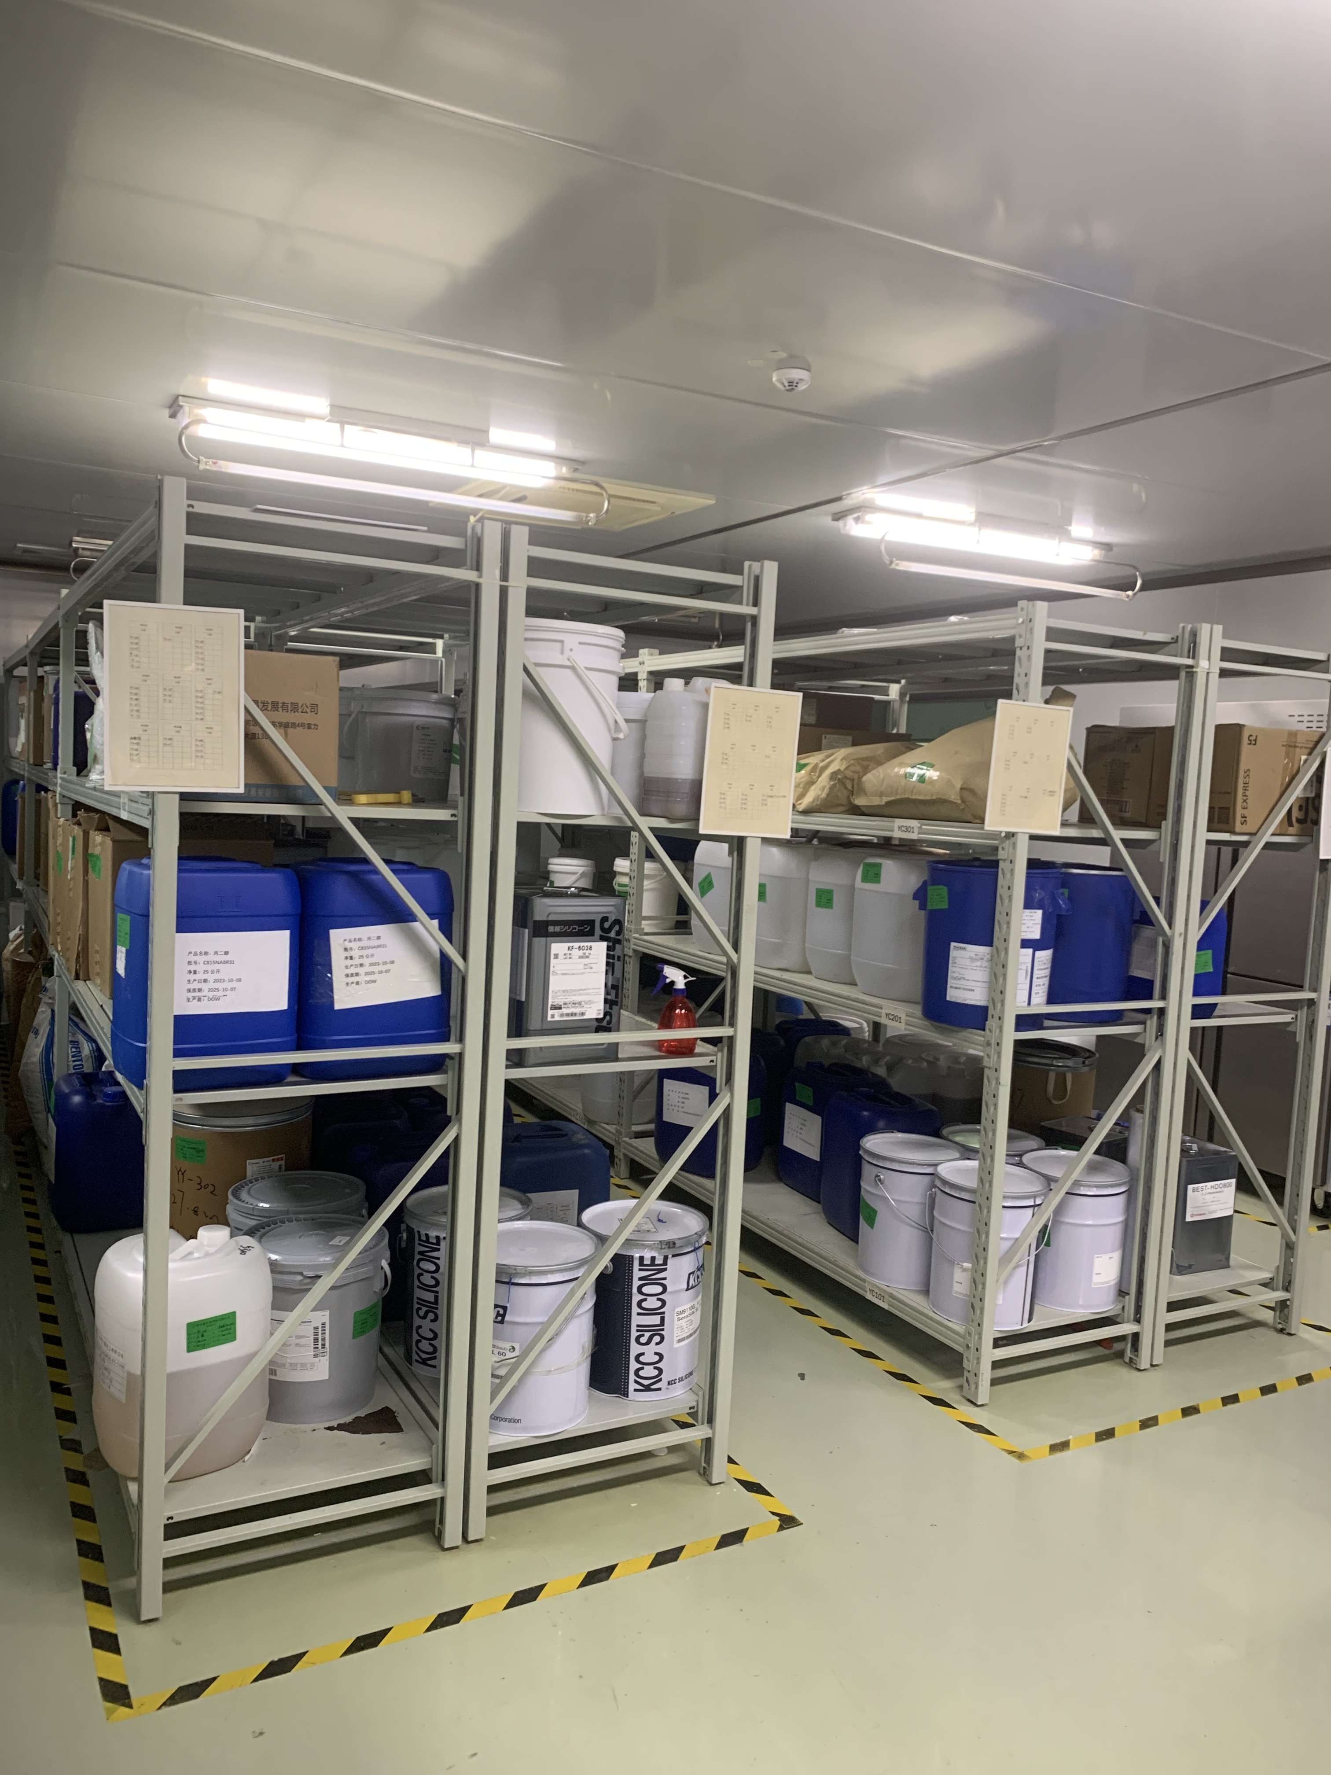
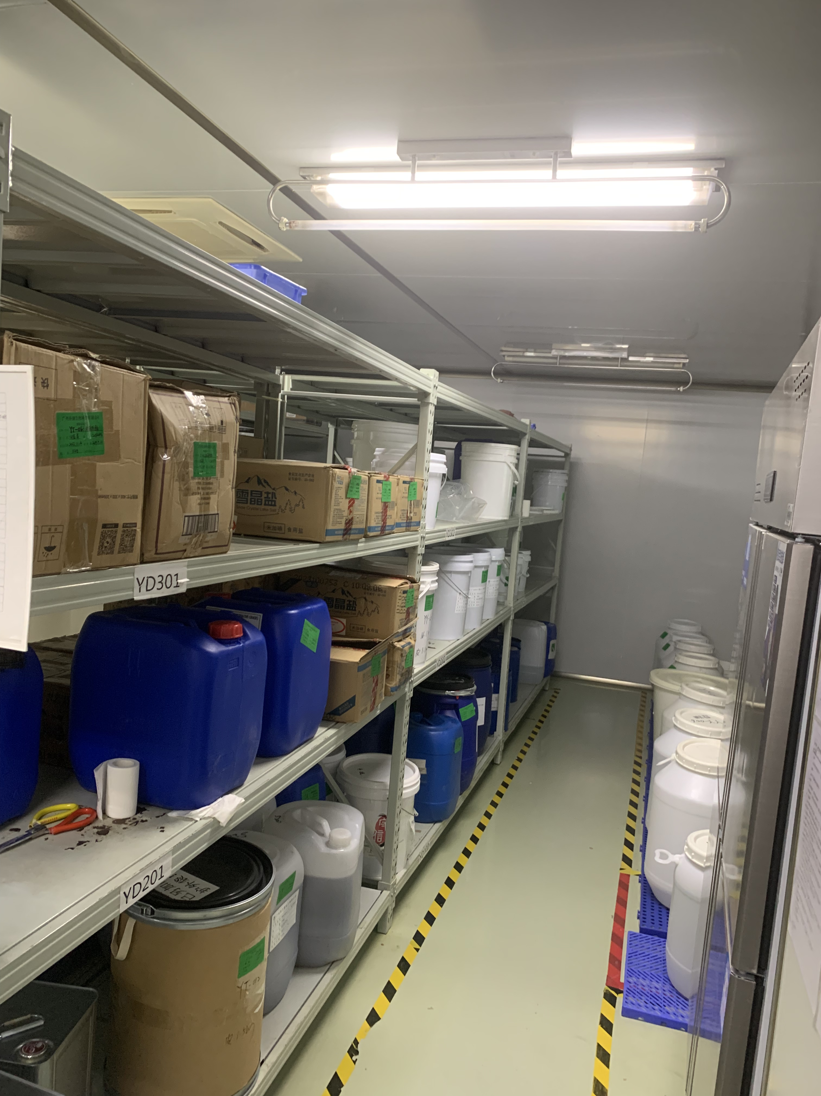
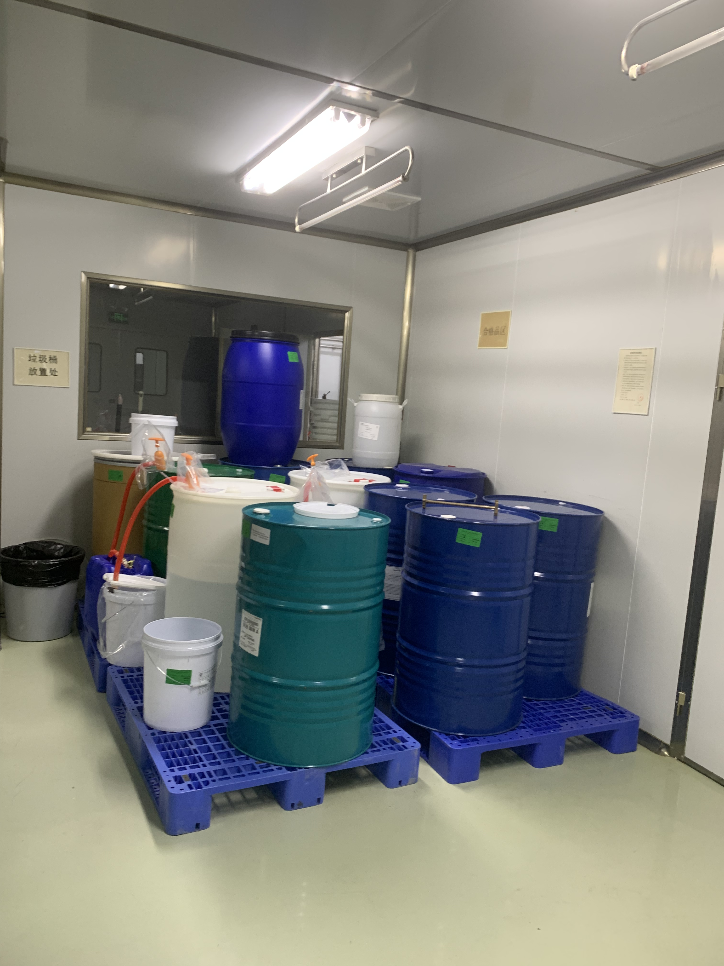
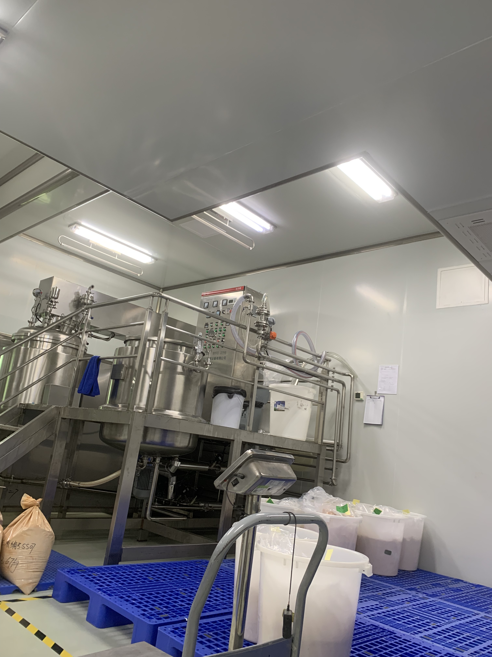
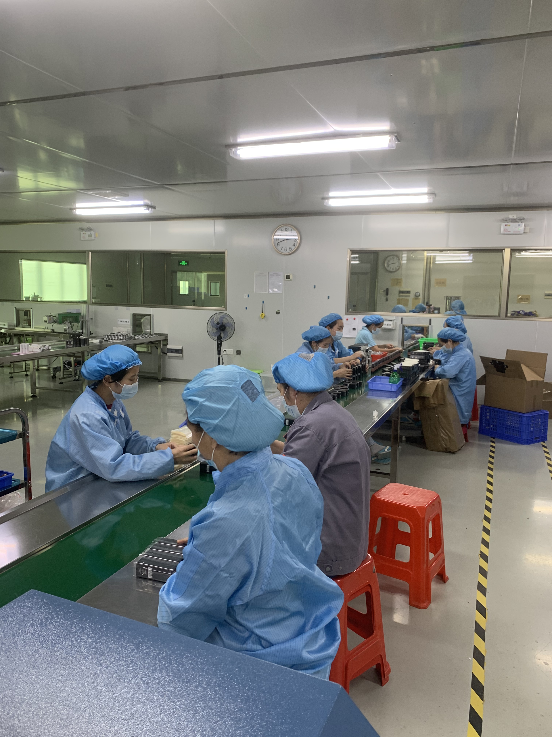
0 3
Material
We have a 100,000-level dust-free workshop, standardized warehouse management, and international standards. Every material is strictly used and properly stored.

Slide 9
Product MOQ
Item
Minimum Qty
Specifications
Tinted Moisturizer
10,000 units
1 formulation
lipsticks
10,000 units
1 formulation 10 colors
Lip Gloss
10,000 units
1 formulation
lip Balm
10,000 units
1 formulation
Lipliner&Lip Grayon
10,000 units
1 formulation 3colors
SPF Sunscreen
10,000 units
1 formulation
Face crem mask
10,000 units
1 formulation
Make up remover
10,000 units
1 formulation
Remover Gream
10,000 units
1 formulation
Serum
10,000 units
1 formulation
Foundation
10,000 units
1 formulation 5 colors
Primer
10,000 units
1 formulation
Concealer&Contour
10,000 units
1 formulation 2 colors
Highlighter&Bronzer
10,000 units
1 formulation 2 colors
Fixer&Loose powder
10,000 units
1 formulation
Blush&Compact
10,000 units
1 formulation 10 colors
Eyeshadow
10,000 units
1 formulation 3 group colors
Eyeliner Pencil
10,000 units
1 formulation 3 colors
Eyebrow
10,000 units
1 formulation 2colors
Cleanser
10,000 units
1 formulation
Toner
10,000 units
1 formulation
Body mist
10,000 units
1 formulation
body scrub
10,000 units
1 formulation

Slide 10
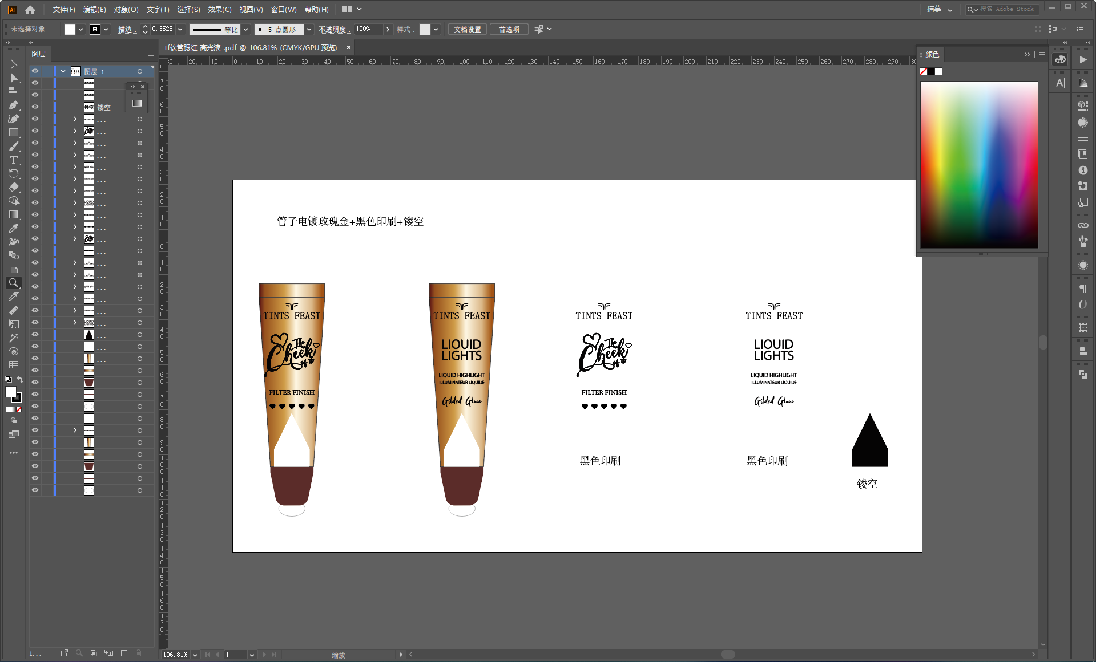

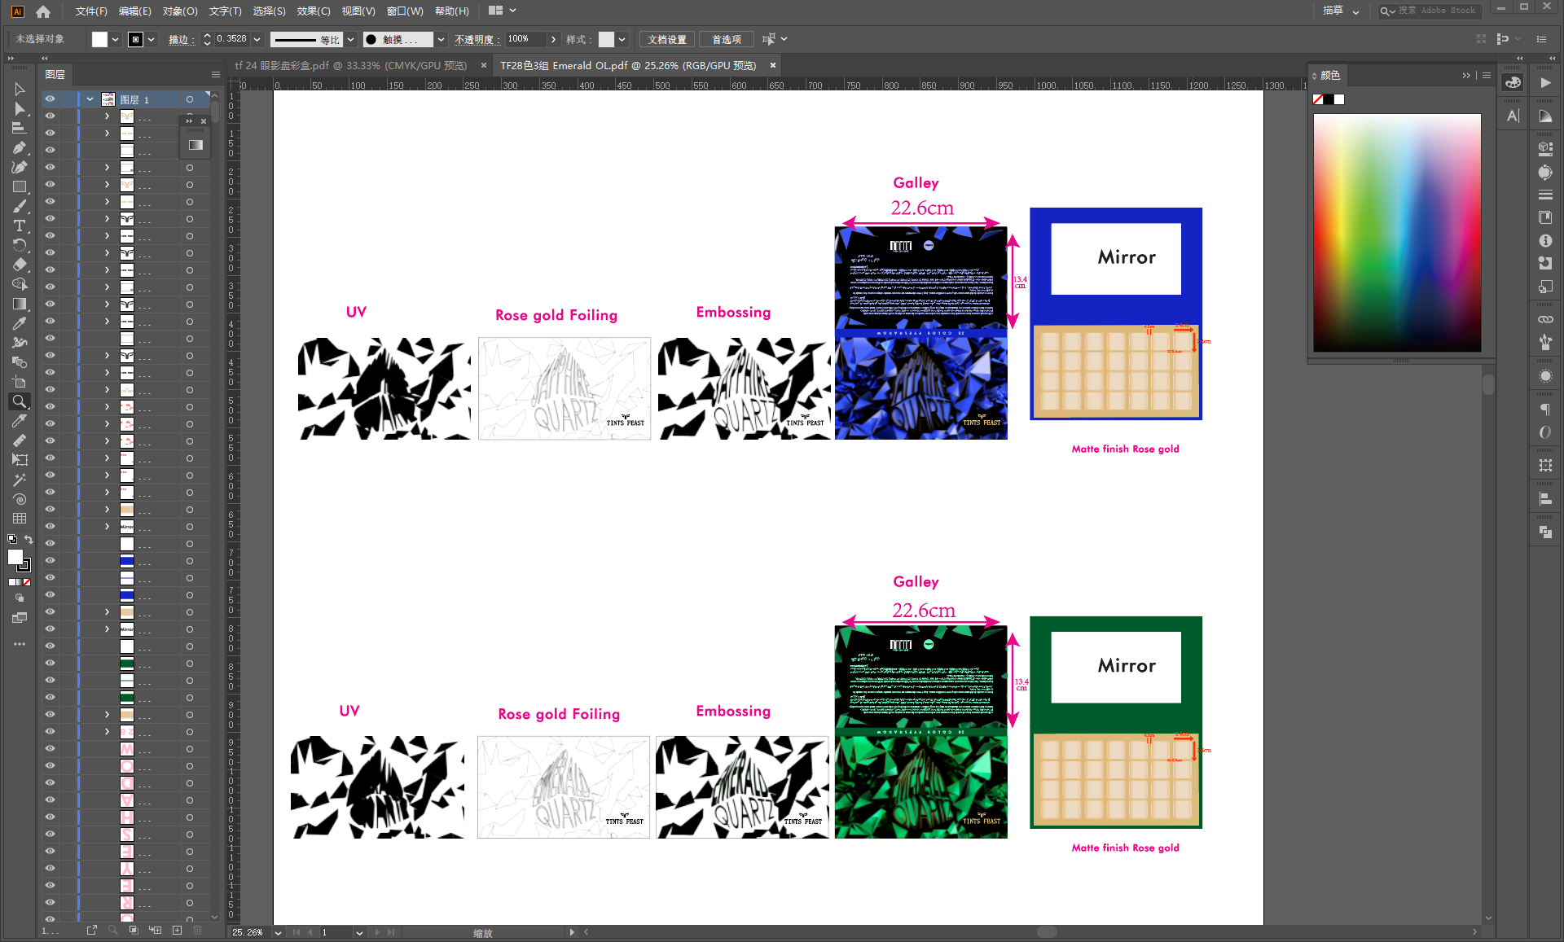
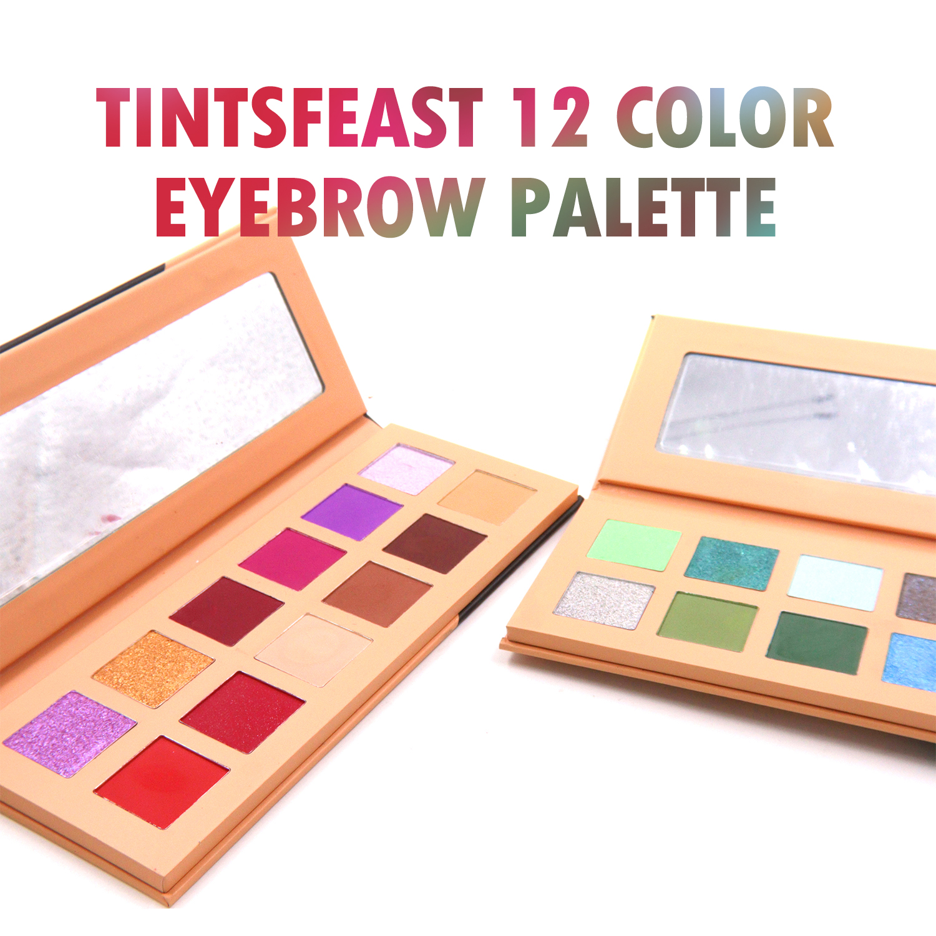
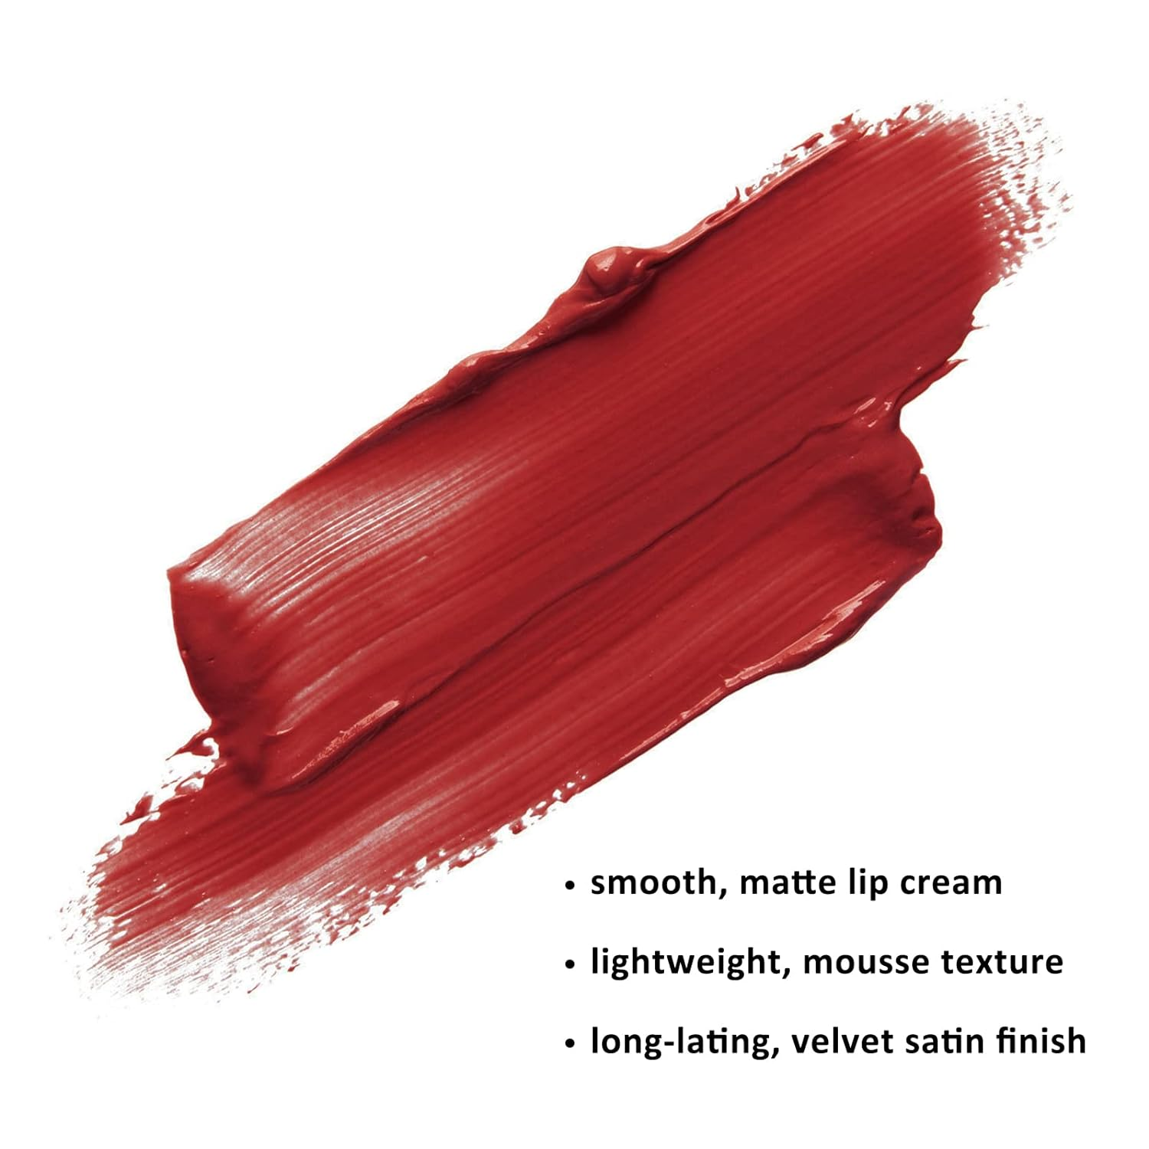
One-stop design service
We have a professional free design team to cooperate from development, design and packaging to finished products, so as to get you a design that meets your market positioning.

Slide 11
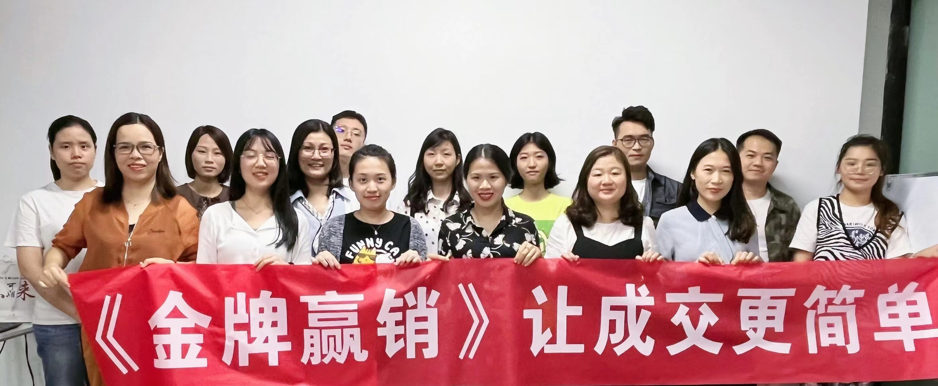
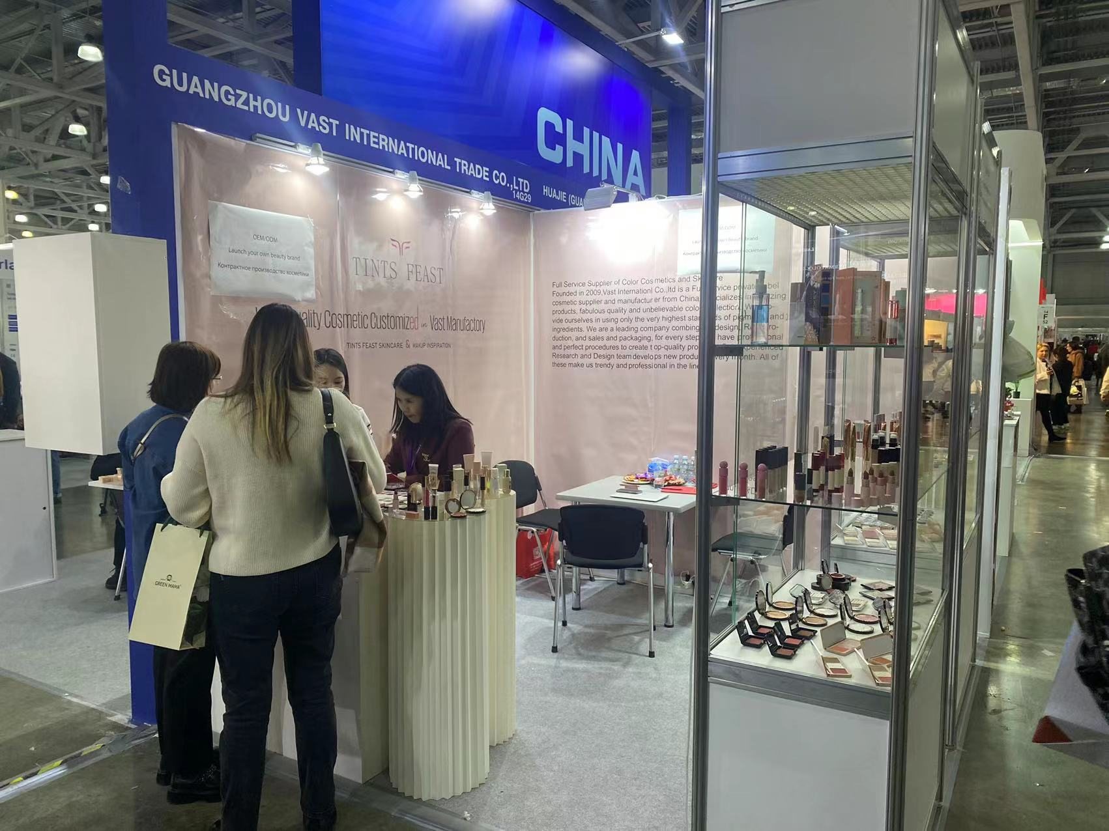
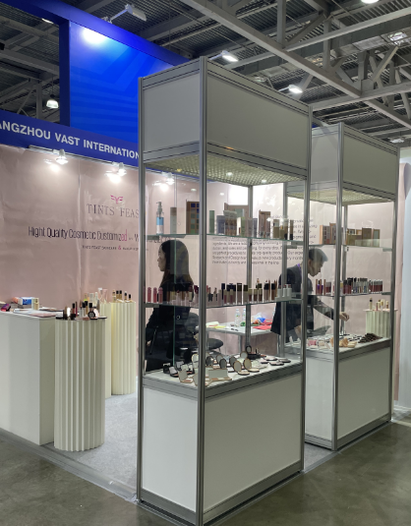
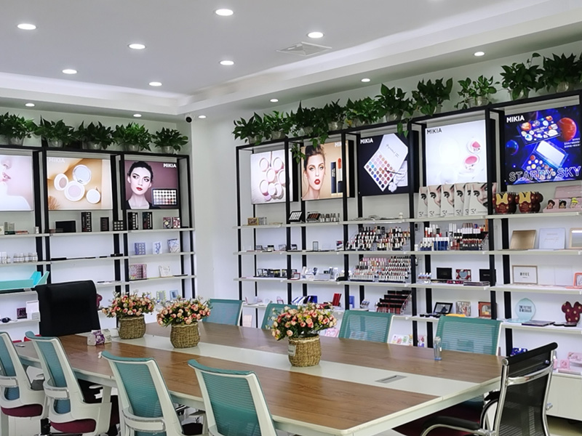
0 1
The
APPEARANCE
With the accumulation of development over time, we have an experienced R&D team and business team that can develop and recommend the most popular products according to customer market requirements.
We actively refer to major exhibitions in the world to showcase our brand and quality, such as the Russian Exhibition, Las Vegas Exhibition, etc. We have our own factory, office area, and exhibition hall for displaying samples. We are a cosmetics company integrating industry and trade. Manufacturer

Slide 12
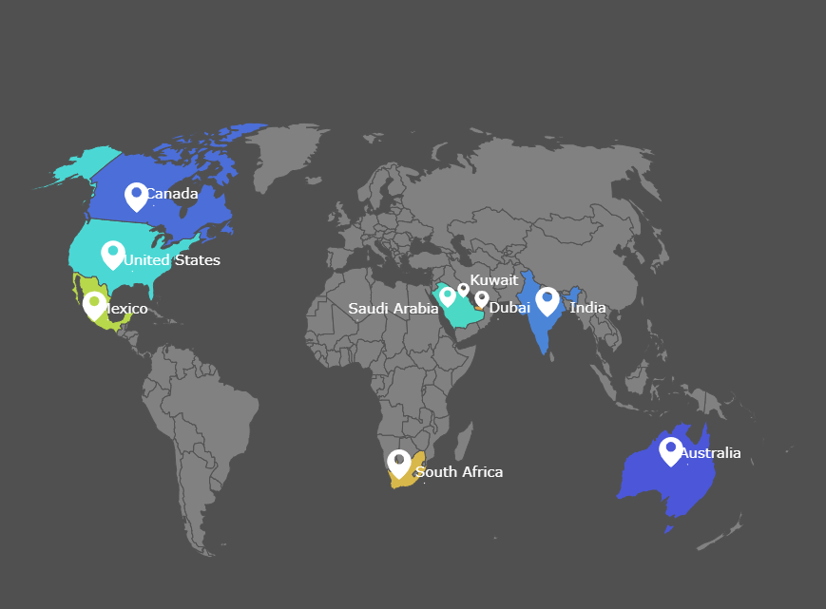
Business map
Our products are currently mainly sold to the United States, Canada, Australia, Mexico, Dubai, Kuwait, Saudi Arabia, India, South Africa and other countries, with an annual sales volume of 5 million US dollars.
Because our supply chain is very stable, some of our customers have moved from very small retailers to local chain supermarkets. Our main performance is also relying on the continuous repeat of orders from our regular partners.

Slide 13
At your service
Contact us
Website: https://www.tintsfeast,com
Email: amy@gzvastcosmetic.com
Whatsapp: +86 18928836443
Address: Room 1212,jiatao Business Buliding, No.91 Sandong Avenue, Huadu District, Guangzhou.

